Slide 1


SAP Full-Stack Developer
Training
ABAP on HANA, UI5 & Fiori, Analytics with OData
Anubhav Oberoy
Day – 5

Slide 2

Agenda – Day 5
Fragments
Fragment loading
Types of Fragments
Working with Messages
---Break---
Fragments as Dialog
Types of Dialog Fragment
Responsive behavior of Dialog
Extending standard Control
Custom Control
Syntax of Custom Control
Steps of create custom control in ui5

Slide 3
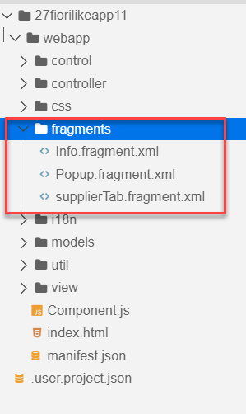
What is fragment ?
Fragments are light-weight UI parts. They are used to modularize views. We can reuse a fragment multiple times in same view or other views.
This class acts as factory which returns the UI control tree defined inside the Fragments.
Fragments are used similar as sap.ui.core.mvc.Views, but Fragments do not have their own controllers. Logic related to fragment’s UI elements is written in the host view’s controller.
Fragments are used similar as sap. ui.
Do not call the Fragment constructor directly!
Use-cases for Fragments are e.g.: - Modularization of UIs without fragmenting the controller structure - Re-use of UI parts - 100%- declarative definition of Views.
Constructor of Fragment is new sap.ui.core.Fragment()
View
View
Popup
Fragment
Popup
View
View
Popup

Slide 4
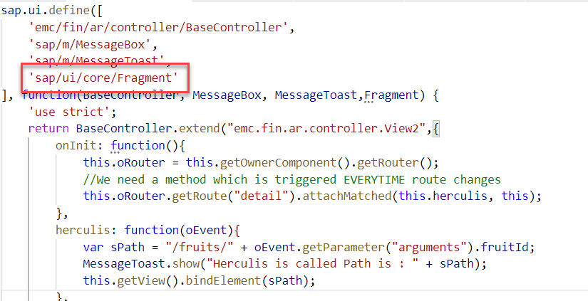
Fragment loading
Loads and instantiates a Fragment. A Promise is returned, which resolves with the Fragments content.
The Fragment types "XML", "JS" and "HTML" are available by default; additional Fragment types can be added using the sap.ui.core.Fragment.registerType() function.
Fragments can be instantiated from JSViews, as well. Fragments of any type can be used within views of any type.
Module name for fragment loading is “sap/ui/core/Fragment”

Slide 5
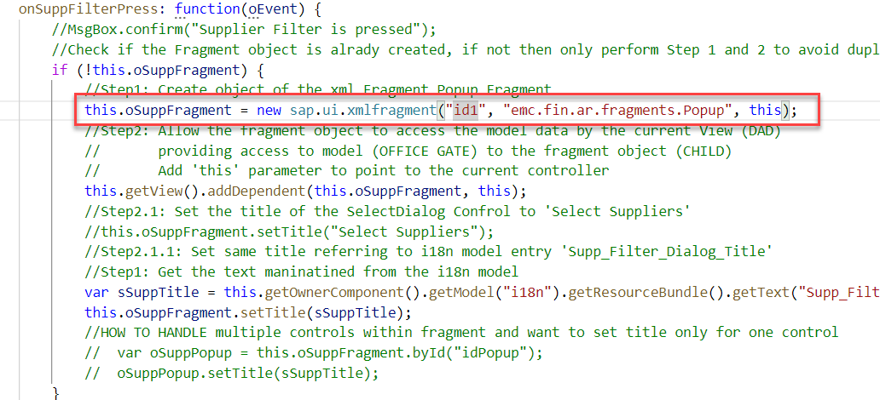
Loading a XML fragment (default type)
Create object of the xml Fragment Popup Fragment
Trainer: Anubhav Oberoy

Slide 6
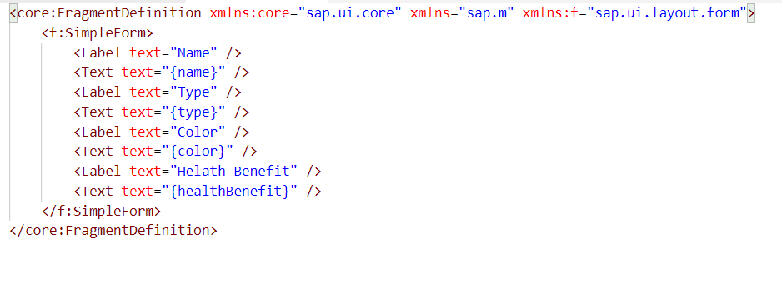
Create a XML fragment
XML fragments are similar to XML view, but have no <View> tag as root element. Instead, there is a SAPUI5 control.
Trainer: Anubhav Oberoy

Slide 7

Exercise
Create a XML fragment
1.1 Add Info fragment
1.2 Add supplier data fragment
2. Load a xml fragment in View2.view.xml
Trainer: Anubhav Oberoy

Slide 8
What is Message
Messages can be used to notify the user about specific states of the application and can help the user to correct their incorrect inputs.
SAPUI5 provides a central place for storing and managing info, warning, and error Messages.
Message Object Properties
Target: Describes the part of the application to which the message applies.
Message processor: The object that handles the message in the application and propagates the message to correct controls , binding, or other object.
Types: Defines the severity of the message; possible types are error, warning, info, success.
Message Text: The actual message text describing the issue.
Persistent: This property influences the lifecycle of the message.
Trainer: Anubhav Oberoy

Slide 9
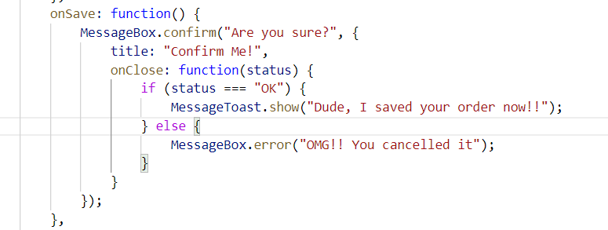
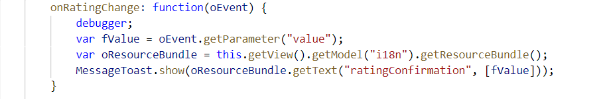
Message Dialog
A message dialog interrupts the user's workflow by blocking the current page and needs to be closed by the user.
Use a message dialog if the message is important and must be acknowledged by the user.
The easiest way of showing message dialog is to use the sap.m.MessageBox.
Trainer: Anubhav Oberoy

Slide 10
Types of MessageDialog
MessageStrip is a control that enables the embedding of application-related messages in the application.
A message toast is a small, non-disruptive popup for success or information messages that disappears automatically after a few seconds.
Method: sap.m.MessageToast.show()
MessageBox provides several functions:
show(), alert(), confirm(), error(), information(), success(), warning
MessageBox
MessageToast
MessageStrip

Slide 11

Break
Trainer: Anubhav Oberoy

Slide 12
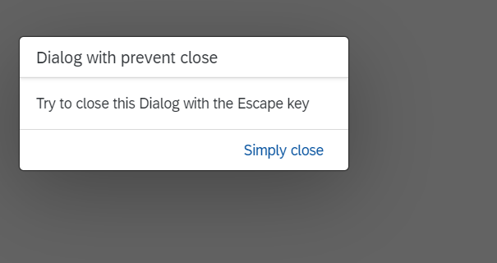
Fragment as Dialog
The Dialog control is used to prompt the user for an action or a confirmation.
It interrupts the current app processing as it is the only focused UI element and the main screen is dimmed/blocked.
The content of the Dialog is fully customizable.
API Reference: https://sapui5.hana.ondemand.com/sdk/#/api/sap.m.Dialog%23overview
Structure of Dialog:
A Dialog consists of a title, optional subtitle, content area and a footer for action buttons.
The Dialog is usually displayed at the center of the screen.
Its size and position can be changed by the user. To enable this, You need to set the properties resizable and draggable accordingly.
Trainer: Anubhav Oberoy

Slide 13
Responsive behavior of Dialog
Uses:
To display a system message.
To interrupt the user’s action.
To show a message with a short and a long description.
Behavior:
If the stretch property is set to true, the Dialog displays on full screen
If the contentWIdth and/or contentHeight properties are set, the Dialog will try to fill those sizes.
If there is no specific sizing, the Dialog will try to adjust its size t its content.
Smartphones
If the Dialog has one or two actions, they will cover the entire footer. If there are more actions, they will overflow.
Tablets
The action buttons in the toolbar are right-aligned. Use cozy mode on tablet devices.
Desktop
The action buttons in the toolbar are right-aligned. Use compact mode on desktop.
Trainer: Anubhav Oberoy

Slide 14

Exercise
Add a Dialog box
Add a Select Dialog fragment
1.1 add a filter in supplier data
2. Add a filter button in Supplier fragment
3. Add a filter functionality in view2 controller
Trainer: Anubhav Oberoy

Slide 15
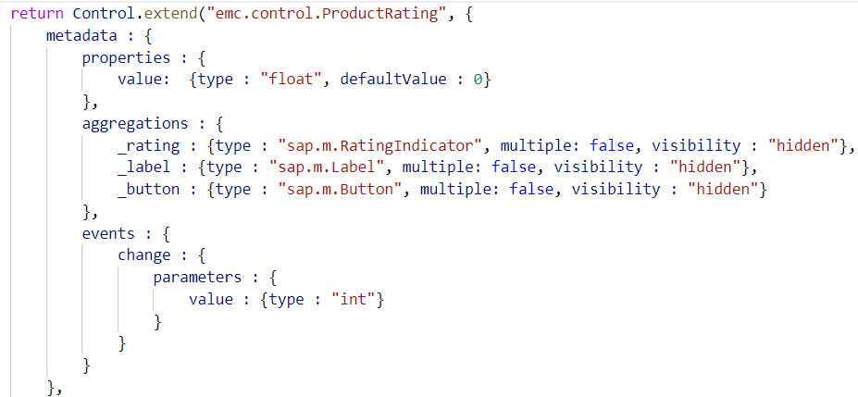
Custom control
A custom control is a JavaScript object that has two special sections ( metadata and renderer ) and a number of methods that implement the functionality of the control.
The metadata section defines the data structure and thus the API of the control.
The init method is a special function that is called by the SAPUI5 core whenever the control is instantiated.
SAPUI5 allows string, int, float, Boolean, object and arrays of the mentioned types as predefined data types.
In case if there is functionality which us not delivered by SAP, We can design our own control.
sap.ui.core.Control is the super class of all UI Controls
Extends is the keywords used to indicate inheritance in JS.
Trainer: Anubhav Oberoy

Slide 16
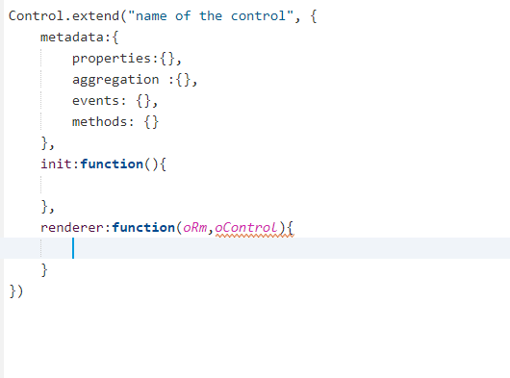
Syntax of Custom Control
sap.ui.core.Control is the super class of all UI Controls
Extends is the keywords used to indicate inheritance in JS.
oRm is the renderer object to talk to the browser and tell the browser to put something in DOM
Object of the current control which we are designing, with the help of this object oContol, we can access properties
Trainer: Anubhav Oberoy

Slide 17
Steps of create custom control in ui5
A custom control is a JavaScript object that has two special sections ( metadata and renderer ) and a number of methods that implement the functionality of the control.
There are different types of steps:
01
02
03
04
05
.
Create a folder in webapp – control
Use the custom control and define function in controller & view
Create a sample SAPUI5 project
Create a js file in control
Provide a control name
Trainer: Anubhav Oberoy

Slide 18

Exercise
Add a rating indicator for customer
Add a new folder with name control and make a js file(ProductRating.js) in this folder
Add a functionality in view2 xml
Add a functionality in view2 Controller
Update i18n file
Update the version in manifest file
Trainer: Anubhav Oberoy

Slide 19

End of Day 5

Slide 20

Questions

Slide 21

Anubhav Oberoy

Slide 22


We’re committed to empower you to be
Most Desirable Resource
through powerful training solutions.
We build the workforce of the future.
250+
Corporate Clients
30,000+
Learners Trained
25000+
Learners Placed
FREE WEBINARS
Sign up for free webinars with industry experts every fortnight!
Enroll Now!
Contact us today!
https://anubhavtrainings.com/

Slide 23




More from AnubhavTrainings.com

